Slide 1


Metabolic Complication in HIV & Treatment
Dr. Nuru .K. Mgori
MD,MMED
Senior Clinical Mentor
Oshana, Omusati and Kunene
24th April 2018

Slide 2
Learning Objective
Overview of Metabolic Disorders in HIV
Types of ART and Metabolic Disorders
Concern, Intervention and Prevention methods
The speaker has no significant financial conflicts of interest to disclose.

Slide 3
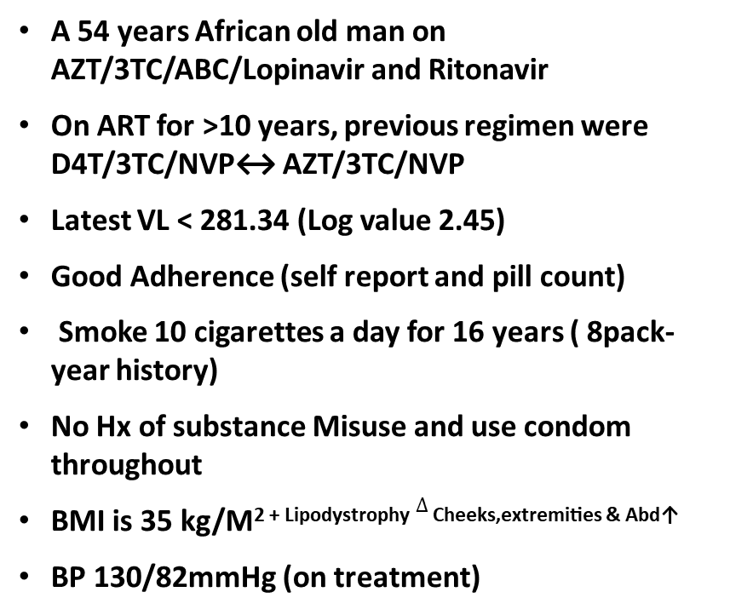
Preamble (Case Study)
A 54 years African old man on AZT/3TC/ABC/Lopinavir and Ritonavir
On ART for >10 years, previous regimen were D4T/3TC/NVP↔ AZT/3TC/NVP
Latest VL < 281.34 (Log value 2.45)
Good Adherence (self report and pill count)
Smoke 10 cigarettes a day for 16 years ( 8pack-year history)
No Hx of substance Misuse and use condom throughout
BMI is 35 kg/M^{2 + Lipodystrophy} $∆$ ^{Cheeks,extremities & Abd↑}
BP 130/82mmHg (on treatment)
Results
HBA1C 7.8%
Total Cholesterol 6mmol (↑)
TG 7.8 mmol
HDL 0.8mmol(↓)
Compared to HIV negative patients this patient`s risk of Coronary Heart Diseases (Heart Attack) is
Less likely
The same
Greater
I don’t know
https://www.mdcalc.com/framingham-coronary-heart-disease-risk-score

Slide 4

HIV infection has changed from a fatal disease into a chronic condition
This means long-term exposure to ART
and higher risk for non-HIV-related conditions
3000
80
ACTIVE PATIENTS
70
2500
60
2000
50
Deaths
Number of patients
Mortality per 100 patient-years
1500
40
30
1000
20
New patients
500
10
0
0
84
86
88
90
92
94
96
98
00
02
www.aids2012.org
Data from Hospital Clinic, Barcelona

Slide 5
Overview of Metabolic Disorders in HIV
HIV infection and Metabolic Disorders
HIV infection itself contributes to the development of metabolic disorders.
Studies have shown that people with HIV without ART have
high levels of Triglycerides
Increase basal lipolysis (production)
low levels of total cholesterol (TC), LDLcholesterol (LDL-C) and HDL-cholesterol (HDL)
Low CD4 count (CD4 < 200 cell/ml), Hep B or C and Low Growth Hormones levels
Hemkens LG, Bucher HC. HIV infection and cardiovascular disease. Eur Heart J 35: 1373-1381, 2014

Slide 6
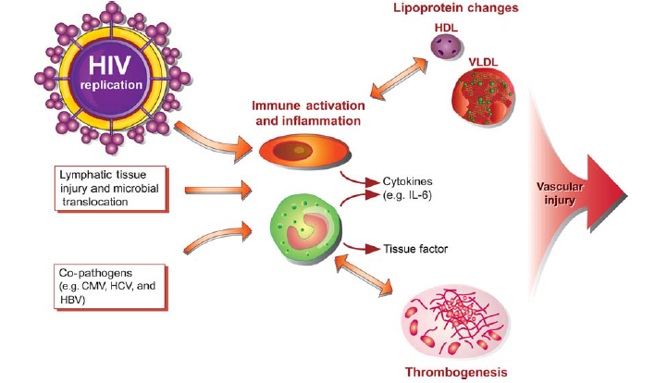
High VL > 1000
Low Level VL
(40-1000)
Pre-ART
Baker J and Lundgren Eur Heart J. 2011
TG
C-RP and tumor (TNF) receptors 1 and 2, are linked with an increased risk of developing diabetes, highlighting the role of chronic inflammation
DVT

Slide 7
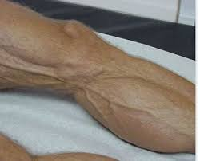
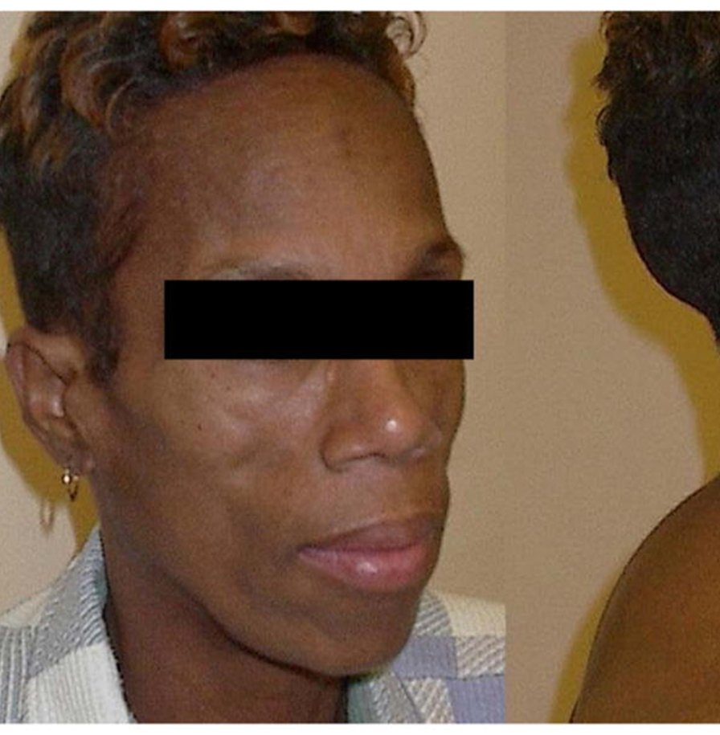
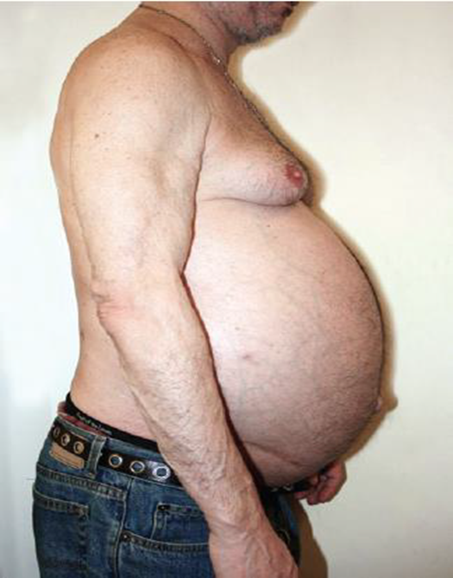
ART and Metabolic Disorders
ART and Metabolic Disorders
1.A side effect of ART is represented by a syndrome of lipodystrophy
2.Affecting 1/3 of all pts on ART
3. Aging Population
4. Traditional risk factors
Lipoatrophy
D4T/AZT and Mitochondria toxicity
Lipohypetrophy
Both
Insulin Resistance
Dyslipidaemia, hypertriglyceridemia, low-HDL-C and glucose metabolism disorders

Slide 8
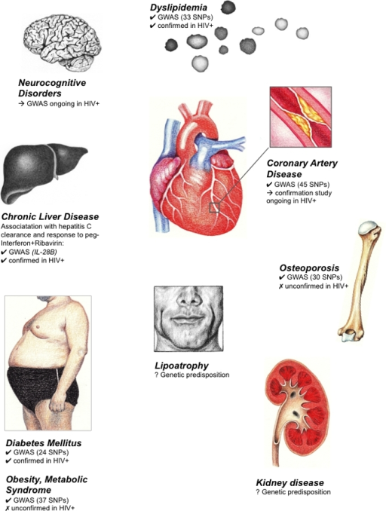
Type of ART and Metabolic Disorders
PI, EFV
EFV
ABC,PIs (LPV/r)
TDF
D-Drugs (D4T)
AZT
TDF
PIs

Slide 9
HIV-infected patients have a higher incidence of myocardial infarction
A
B
RR 1.75
12
n = 3,851
p <0.0001*
100
10
80
8
n = 1,044,589
60
Events Per 1000 PYs
Events Per 1000 PYs
6
40
4
20
2
0
0
18-34
35-44
45-54
55-64
65-74
HIV+
HIV-
# of MI 189 26,142
Age Group (Years)
* Adjusted for age, gender, race, hypertension, diabetes and dyslipidaemia. Proportion of patients with hypertension, diabetes and dyslipidaemia significantly higher in HIV-positive vs HIV-negative cohort
Triant V et al. J Clin Endocrinol Metab 2007; 92: 2506-2512
Notes:
Comments: smoking data not available; could be that smoking rate higher in older HIV-positives; but analysis in subset with smoking data yielded similar results; thus other factors such as HIV itself, inflammation, ART to be considered.

Slide 10
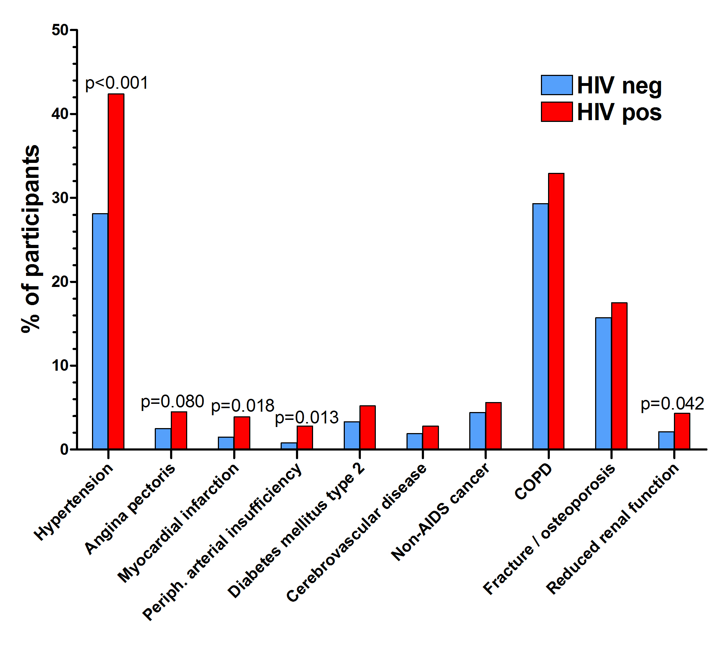
Comorbidity distribution
Schouten J et al. World AIDS Conference July 2012
*
Notes:
All Presentations
26 April, 2001
Satellite Symposium (FINAL)
10

Slide 11
Is lipodystrophy a serious health problem?
Too much fat gain can increase the risk of CVD and DM.
Fat gain in the breasts (Gynecomastia) can be painful
Upsetting and affect a person’s self-esteem
Risk Poor Adherence
Can lipodystrophy be cured?
Surgery?
More research is needed
Tesamorelin (Egrifta)

Slide 12
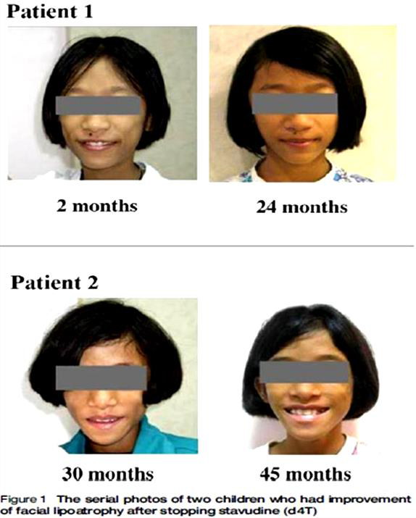
Is facial Lipoatrophy Reversible?
Facial Lipoatrophy may improve after stopping d4T or AZT
Improvement found in 23%, at mean duration of 45 months after stopping d4T, around early adolescence
Sawawiboon N. International Journal of STD & AIDS 2012; 23: 497–501

Slide 13
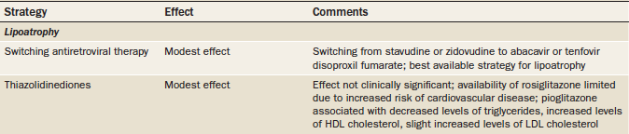
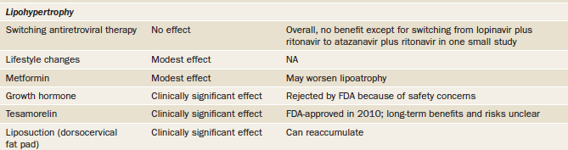
Take home message

Slide 14
Managing cardiovascular risk
Exposure to certain protease inhibitors and abacavir have been associated with cardiovascular events, but these data are controversial
Current data also indicate that cardiovascular events in HIV-infected patients are closely associated with traditional cardiovascular risk factors.
Smoking cessation also leads to a reduction in cardiovascular events
Hypertension is another modifiable cardiovascular risk factor

Slide 15
Prevention Methods
Test and Treat Model (↓Effect of HIV role)
New molecules CCR5 Inhibitors (Maraviroc) and ISTIs (DTG)
Avoid NRTIs (Thymidine Analogues)
Routine Hx taking, Physical Examination and Individualized Blood test
Every clinical visit, educated on risk reduction for CVD (page 51)
WT, BMI calculation or Waist /Hip ratio
Blood pressure assessment
RBG every 6 months for pts with CVD
Random blood cholesterol once a year for all patients on ART
Fasting lipogram for at risk patients (HTN, DM & Familial dyslipidaemia)
Adaptation of Integrated care
One stop shop Clinic and consultation (Shanamtango Clinic)
Clinical Mentor Consultation or HIV Care Physician

Slide 16
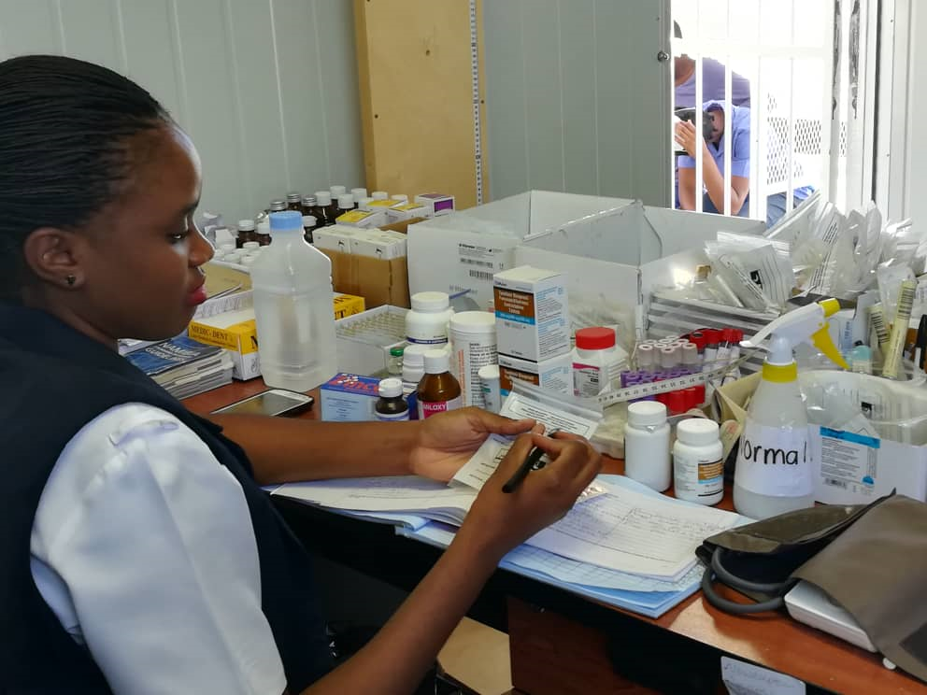
One-Stop shop Consultation ? Paradigm shift in Holistic Care

Slide 17
Key Points
Lipoatrophy, central lipohypertrophy, dyslipidaemias and insulin resistance are common among HIV-infected individuals and probably contribute to these patients’ increased risk of CVD and DM
The cause of these disorders is multifactorial and includes the effects of chronic HIV infection, direct and indirect toxicity of ART
ART switching to safer regimens is the recommended Intervention
Aggressive screening and treatment of modifiable HIV and cardiovascular risk factors is warranted
??Integrated ART and PHC , a one stop shop consultation as a new model of holistic care in Namibia

Slide 18
Reference
http://echo.unm.edu/initiatives/namibia-hiv/
Hoffmann C, Rockstroh J. The natural course of HIV infection. In: HIV BOOK 2015/16. Rob C. (ed). Medizin Fokus Verlag, Hamburg, pp. 7-10, 2015.
Rockstroh J, Guaraldi G, Deray G. HIV and the body: a review of multidisciplinary management. HIV Med 11(Suppl 2): 1-8, 2010.
Hemkens LG, Bucher HC. HIV infection and cardiovascular disease. Eur Heart J 35: 1373-1381, 2014.
Stanley TL, Grinspoon SK. Body composition and metabolic changes in HIV-Infected patients. J Infect Dis 205(Suppl 3): S383-S390, 2012.
Mehta SH, Moore RD, Thomas DL, Chaisson RE, Sulkowski MS. The effect of HAART and HCV infection on the development of hyperglycemia among
Namibia ART 5th Guidelines (2016)
https://aidsfree.usaid.gov/sites/default/files/na_national_guidelines_art.pdf

